Slide 1



WELCOME
TO
KARNATAKA SMALL SCALE INDUSTRIES ASSOCIATION
VIJAYANAGAR, BANGALORE

Slide 2


VISION
To make KASSIA a leading catalyst for advancement of MSMEs in Karnataka and National leader in supporting MSME development
MISSION
To promote, support and guide the MSMEs in Karnataka to realize their true potential and influence public policy towards that end and foster a climate in which MSMEs can operate profitably by encouraging and promoting positive well balanced economic growth.

Slide 3
ABOUT KARNATAKA SMALL SCALE INDUSTRIES ASSOCIATION (KASSIA)
KASSIA is a voluntary body of entrepreneurs established in 1949.
Serves as an apex body of Small Industries of Karnataka.
Represents about 12,800 direct members and 133 affiliated associations.
Stands as the first ISO certified industries association in India.
ORGANISATION
Registered under Karnataka Societies Act
Functioning on democratic lines with regular annual AGM, election of Council Members & Office Bearers adhering to constitutional bye-laws and established conventions.

Slide 4
Managed by a Council of Management consisting of President, Vice President and 62 members directly elected by the General Body.
Past Presidents and Special Invitees are also part of the system.
The Council of Management is primarily responsible for policy formulation and imparting guidance and direction to the affairs of the Association.
There are 26 Sub committees, on different segments pertaining to Business and Industry
A permanent Secretariat assist in the implementation of policies and day-to-day administration, under the guidance of the Office Bearers.

Slide 5
26 Sub committees of KASSIA, on different segments pertaining to Business and Industry
Non-Designated Industrial Infrastructure Development-Bangalore Urban, KIADB, BBMP & BWSSB)
Industrial Infrastructure Development- Mofussil KIADB ISSUES
KSSIDC - B'loe Urban
KSSIDC- B'lore Rural
GST
Energy
Banking & Financial Institution
ESI & PF
Textiles
Women Empowerment
Labour Laws
Environment & Ecology
Non Designated Industrial Area
Inland Tours & Exhibitions
Overseas Industrial Tours/Exhibitions & Export Promotion
Agro & Rural Industries
Factories & Boilers
Vendor Development Programmes (Pvt. & Public Sector)
Kassia Events/Programmes
New Industrial Estate-BEYOND BENGALURU
Kassia Bulletin/ Circulars & Notifications.
Affiliated Associations
Skill Development
RD& PR / Municipal Area
ISO/BIS/GeM/ZED/Metrology
Moffusil Development committees on each Districts of Karnataka

Slide 6
ROLES & OBJECTIVES
To promote the development of Micro & Small Enterprises in the manufacturing category.
To provide facilities for exchange of information, experience and interests among the Small Industries.
To co-operate with industrial, business, educational and research institutions and other organizations in the collection and exchange of information pertaining to Small Industries.
To undertake professional, technical and management consultation services.
To organize studies, survey and research projects.
To establish common service facilities for its members.

Slide 7
To further the cause of Micro & Small industries by holding consultations with Union and State Government and other bodies.
To conduct and participate in National and International Exhibitions and Trade Fairs.
To publish books, news-papers, periodicals, pamphlets or any other publications of interest to the MSEs in the manufacturing Sector.
To establish Skill Development Centre, Exhibition centre & conduct Exhibitions for the benefit of MSEs in the manufacturing Sector.
To undertake activities incidental to the attainment of the objectives and towards healthy development of MSEs in the manufacturing Sector.

Slide 8
PRESENT RANGE OF SERVICES
Operating Information Service for the MSEs in the manufacturing Sector.
Counselling and Grievances handling
Liaison service with Government and Institutions.
Organising developmental services, training programmes, Seminars, Conference etc.,
Sponsoring study tours, in country and overseas delegations.
Conducting Exhibitions.
Formulating special programmes like Helpline Services, Promotional Campaigns, Interaction Sessions etc.
Initiating Indl. Business, Finance, Research and Management Development exercises.
Facilitating In-plant Training support to Worker, Supervisory & Entrepreneurial Categories.
Serving as representative of MSEs in the manufacturing Sector in several Policy making bodies and programme implementation agencies.

Slide 9
KASSIA HAS CREATED THE FOLLOWING SPECIALIZED CENTRES OF SERVICES
KASSIA Credit Co-operative Society
www.kassia.org.in website
K.L. Nanjappa Foundation
KASSIA Centre of Excellence & Innovation
KASSIA Help Desks – GST, Udyam Registration, KSPCB, ONDC, GEM & SIDBI
KASSIA News YouTube channel

Slide 10
KASSIA REPRESENTATION IN VARIOUS BOARDS:
GOVERNMENT OF INDIA
MSME Advisory Committee
Reserve Bank of India – SLBC Committee
Engineering Export Promotion Council
RBI Empowered Committee
MSME Development Board, New Delhi
ESIC Regional Advisory Committee
Regional Committee E.P.F
Customs, Central Excise, Regional Advisory Committee & Public grievance Committee
NSIC Technical Committee
DGS & D
JD-GFT

Slide 11
KASSIA REPRESENTATION IN VARIOUS BOARDS:
GOVERNMENT OF KARNATAKA
Karnataka Small Scale Industries Development Corporation
Karnataka Centre for Technological Upgradation
VTPC Governing Council
Labour Advisory Committee
Minimum Wages Advisory Board
KSPC Governing Council
Vision Group
KIADB Advisory Board
Government Tool Room & Training Centre
Regional Direct Taxes Advisory Committee of Karnataka
Commercial Taxes Consultative Committee
Special Task Force in Infrastructure
Process Food Advisory Committee-S-Region
MSE-Industrial Facilitation Committee
Rajiv Gandhi Udyami Mitra Scrutiny Committee
BESCOM Technical Committee
KERC Advisory Committee
All District Single Window Committee
Industrial Effluent Management Committee of KSPCB
Karnataka Vocational Training and Skill Development Corporation Ltd.
State Planning Board
Dual System of Training implementing committee
State Level Committee on Standardization (SLCS)
Invest Karnataka – 2022
Permanent Trade Facilitation Committee (PTFC)
Customs Clearance Facilitation Committee (CCFC)

Slide 12
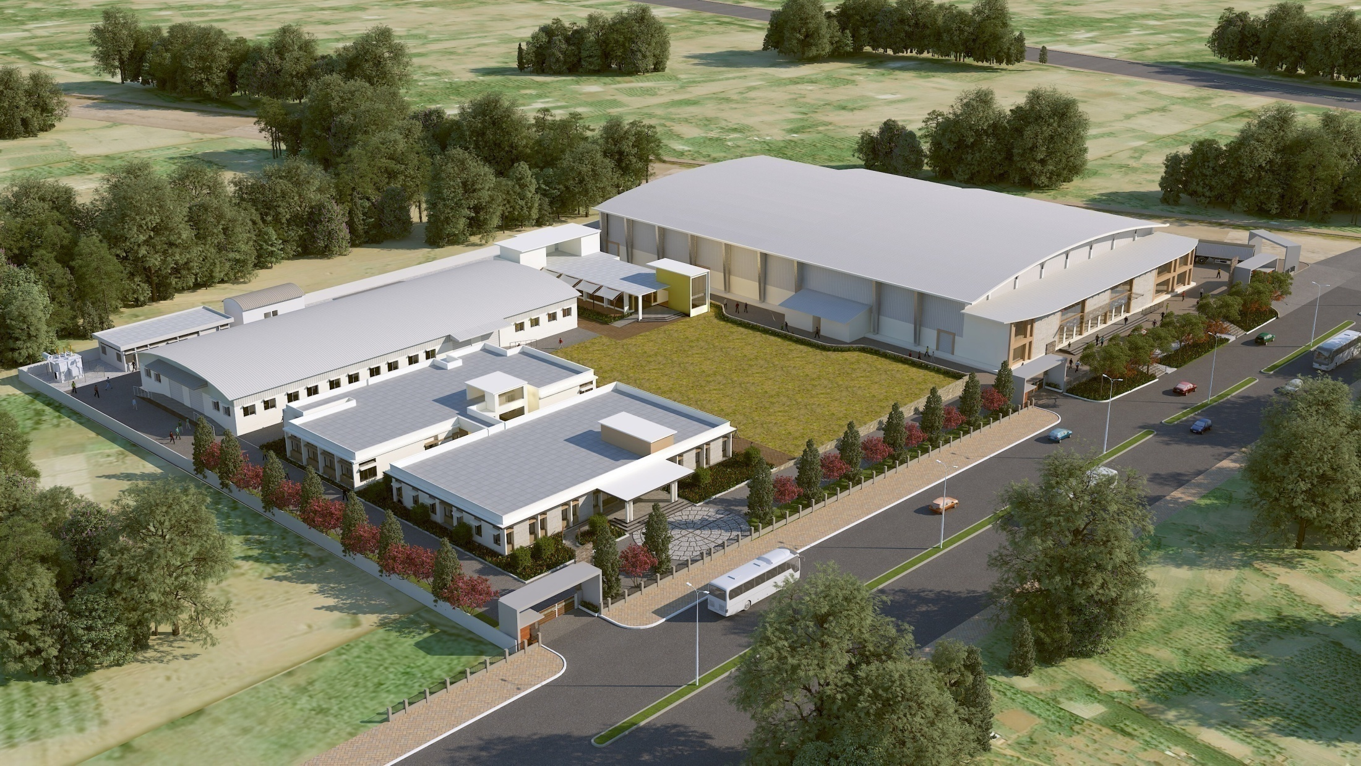
“KASSIA CENTRE OF EXCELLENCE & INNOVATION (KCOE&I)” AT DOBASPET BANGALORE RURAL DIST. KARNATAKA

Slide 13
KASSIA CENTRE OF EXCELLENCE AND INNOVATION (K.C.O.E & I)
The prestigious project of KASSIA coming up at Plot No.4, Avverahalli Industrial Area, Dobaspet 4th Phase, Nelamangala Taluk.
Has the following components:
Exhibition Centre spread over 50,000 Sq.Ft
6 Learning Centres (Academic Block)
6 Technology Centres (Workshop Block)
Administrative Block
Food Court
Facilities (DG Room, Greenery, Security etc)

Slide 14
PROJECT HIGHLIGHTS
An exclusive State-of-Art Exhibition Centre that provides ample scope for MSME of the Globe to showcase their products & technology.
Marketing Enabling Centre with Digital Marketing and Development Facilities.
Innovation Assistance Programme that would give ‘Break-through’ solutions to your needs.
Skill Building and Development Centre that would focus on MSME talent needs as also developmental needs – includes Entrepreneurship Development Programmes

Slide 15
CORE SUBJECTS OF LEARNING CENTRES
Driven by industry needs; Employment opportunities & R.O.I to KASSIA while building Brand Image through Garments & Footwear.
CNC Programming & Operation;
Light Industrial Fabrication and Welding;
Basics of Electrical and Electronics Engineering;
Apparel Making (Uniforms for KASSIA members);
Footwear Uppers – Including Safety shoes.
Artificial Intelligence & Robotics

Slide 16
INNOVATION ASSISTANCE PROGRAM
Intended to get young engineering minds to work on live projects that are of concern to the industry – Guided by
Entrepreneurs/Institutions/R&D Centers / Subject Experts.
Newer Learning Initiatives (Like Manufacturing Associates & Manufacturing Technical Assistant)
Strong Industry-Institute connect that would leverage strong base of KASSIA to student –Industry-Institute fraternity.
Would also build a strong K-CONSULT team that would highlight Management Consultancy Segment

Slide 17
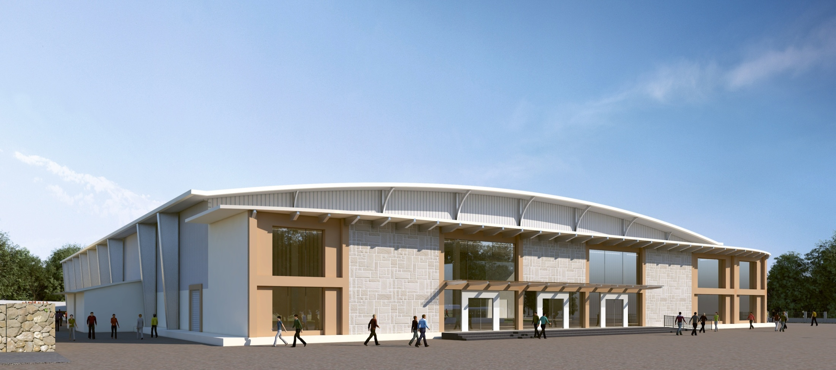
INTERNATIONAL EXHIBITION CENTRE

Slide 18
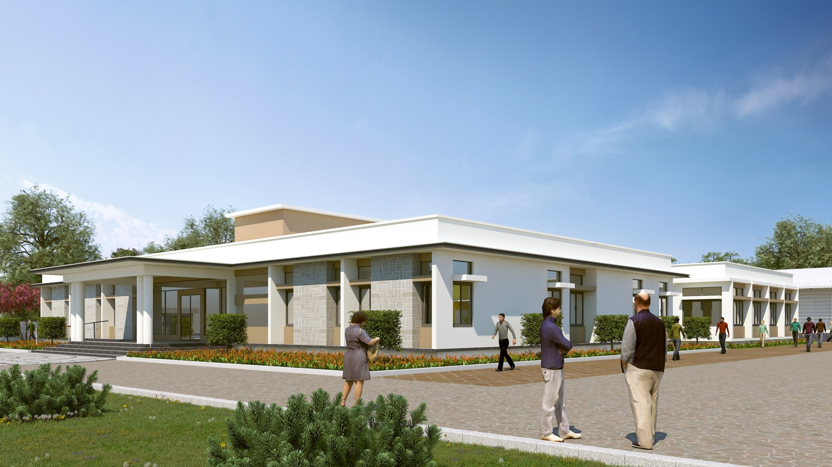
ADMIN BLOCK

Slide 19
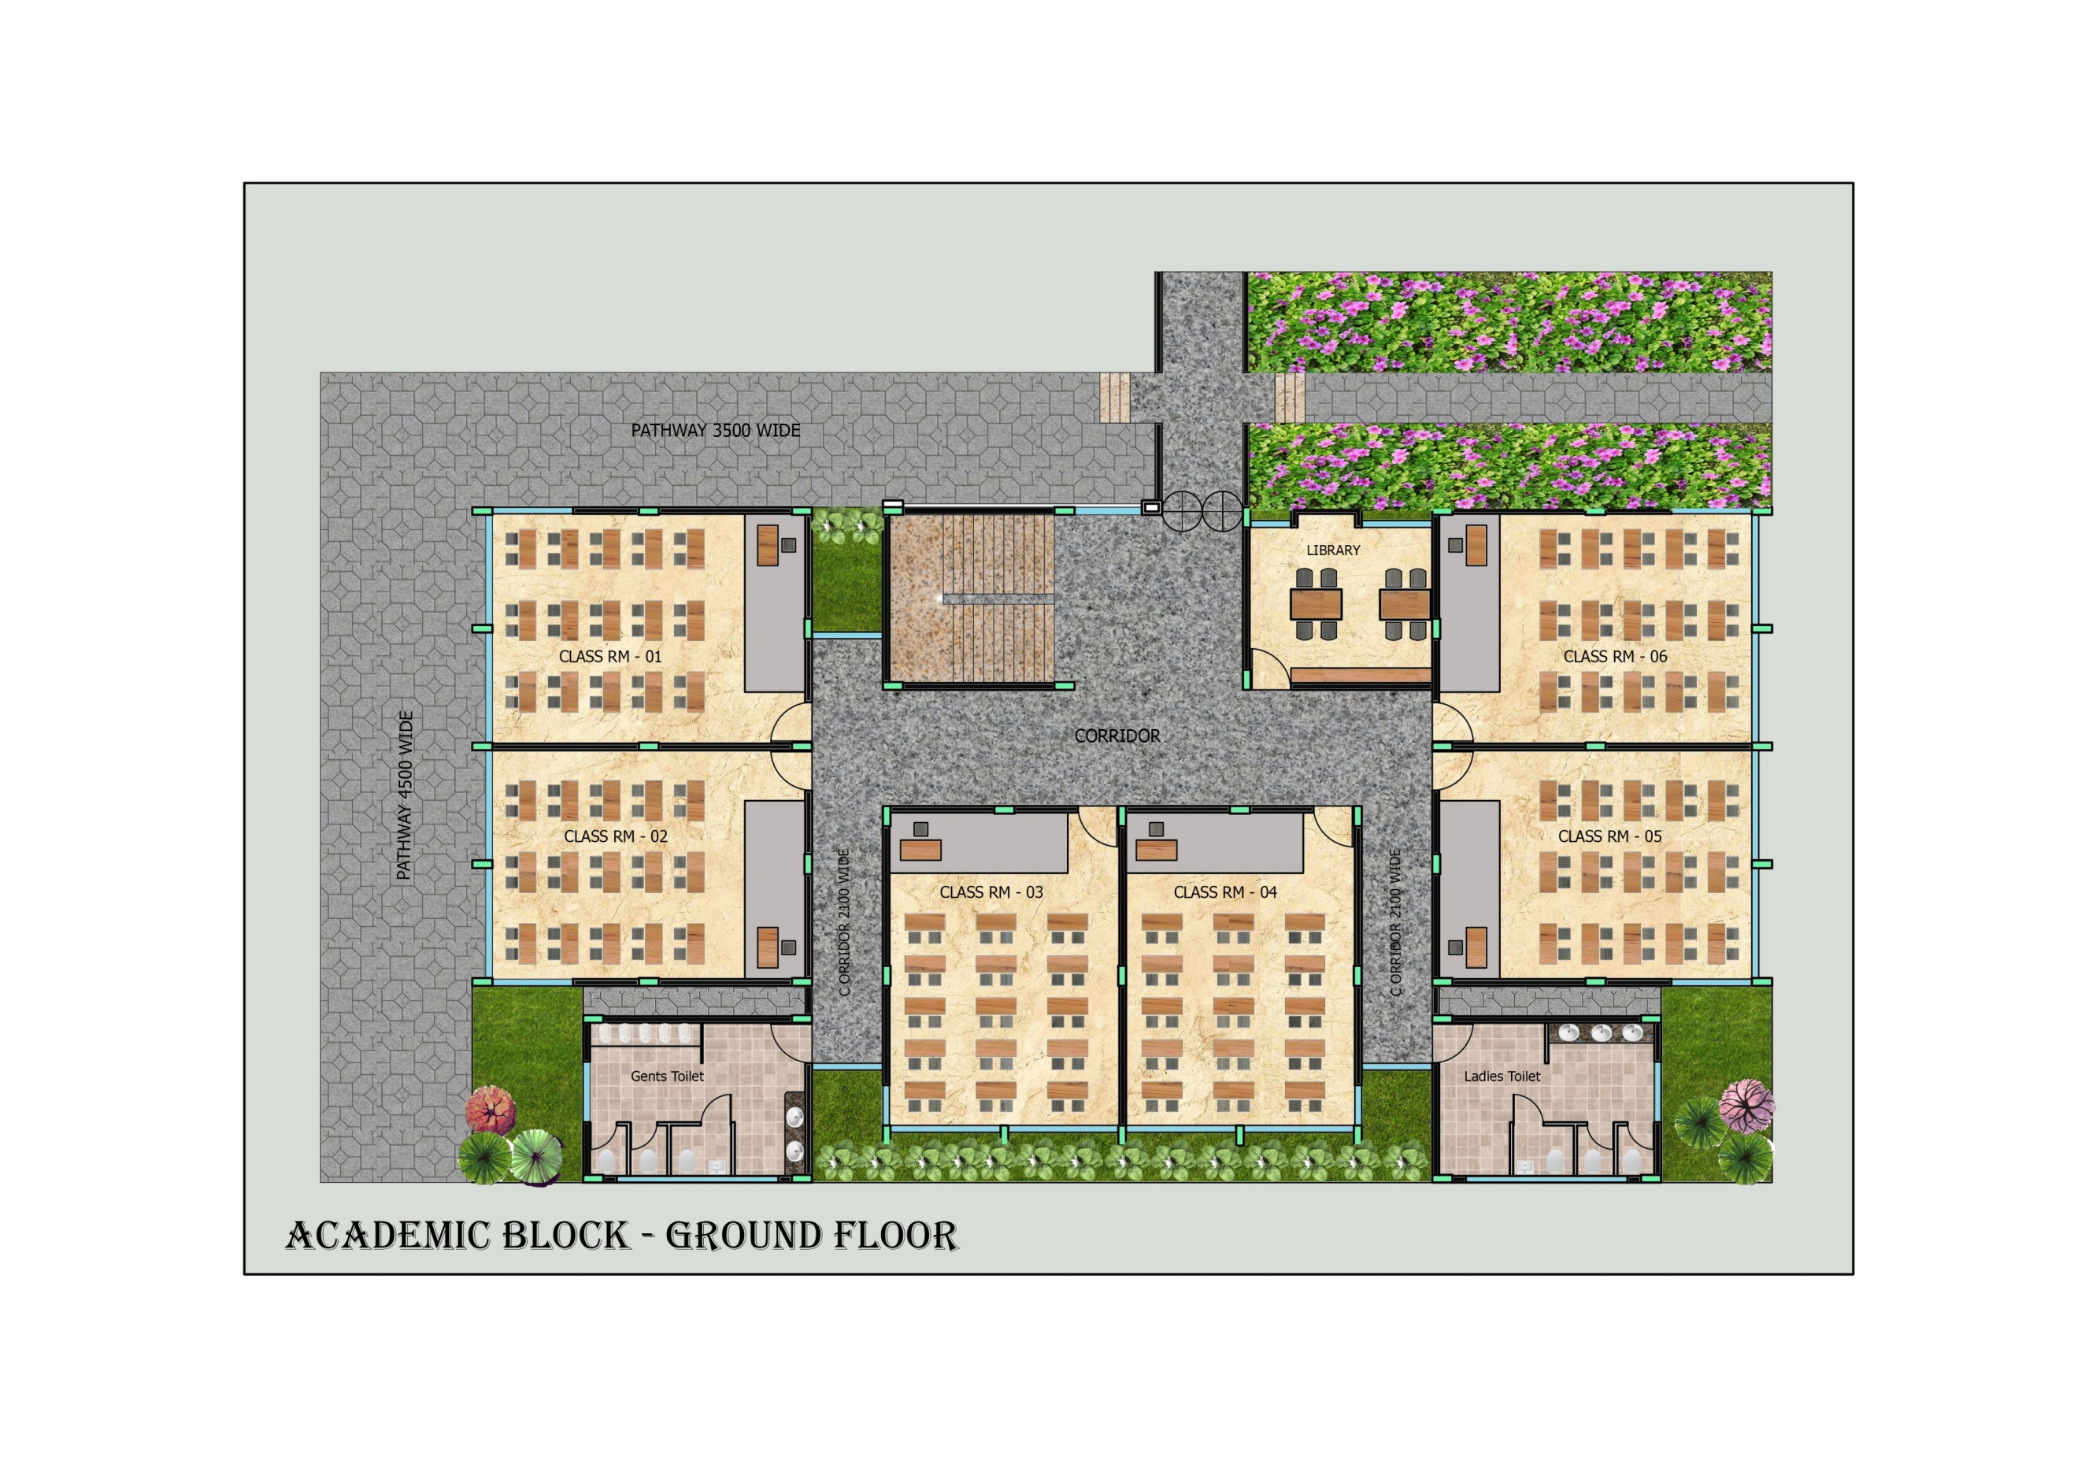
ACADEMIC BLOCK

Slide 20
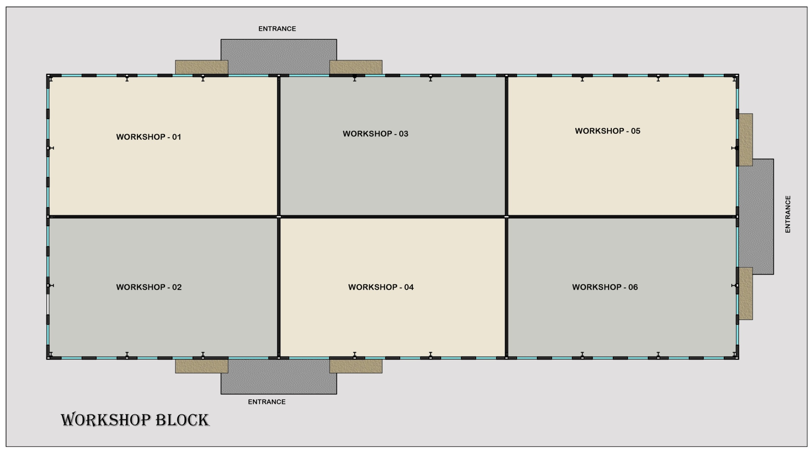
TECHNOLOGY CENTRE

Slide 21
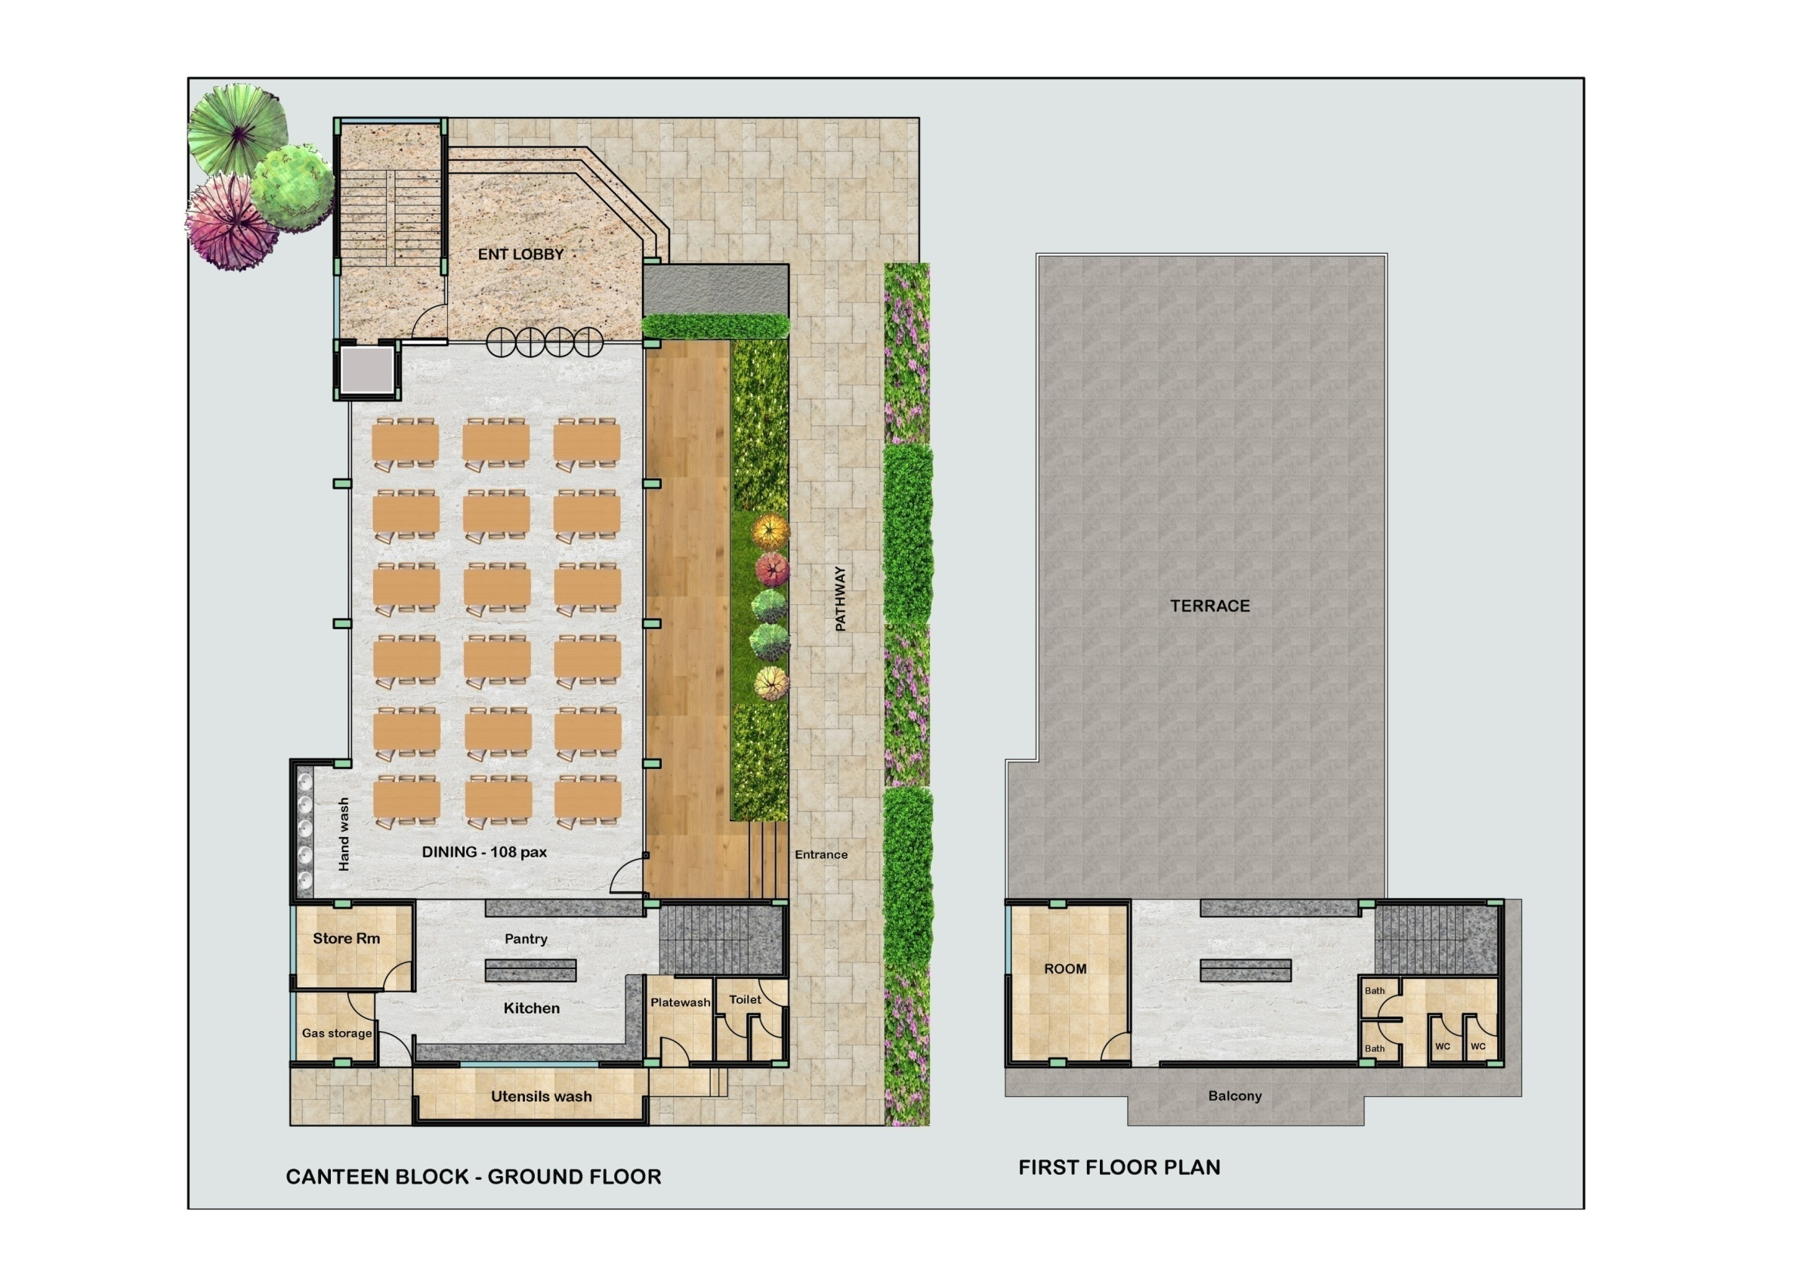
FOOD COURT

Slide 22
THANK YOU

